Slide 1

Riding Pattern between “Casual” & “Member” customers.
Presented By : Aayush Shah
Date : 26 — July, 2021

Slide 2
What is the Problem?

Slide 3
Majority of our revenue
Comes from
Member customers
Note: Percentages according to our financial analysts

Slide 4
So,
Note: Percentages according to our financial analysts

Slide 5
So,
We need to attract
Casuals to purchase
Our membership program
Note: Percentages according to our financial analysts

Slide 6

Plan to discuss
1
2
3
Share an overview and the background of analysis
Look at the example and patterns in their riding style
Interpret insights and share recommendations
Here will talk about the data, source and motivation about the analysis
Here I will present the visualizations and other data tools to guide my insights
We will end our presentation by having discussions and recommendations

Slide 7
DATA Used is →
Data Size
~ 5.5 Million Records
& with 12 Attributes (4GB)
Time span
1st Jan 2020 — 30th June 2021
(Access data and cleaning steps from appendix)
Cleaning?
Data used as cleaned and transformed
Ready-to-use format.
Data Origin
Recorded live by our systems
At stations and stored in Cyclistic’s server

Slide 8
DATA Used is →
That Big Brother Looks
Like
(Access data and cleaning steps from appendix)

Slide 9
DATA Used is →
That Big Brother Looks
Like this ↓
(Access data and cleaning steps from appendix)

Slide 10
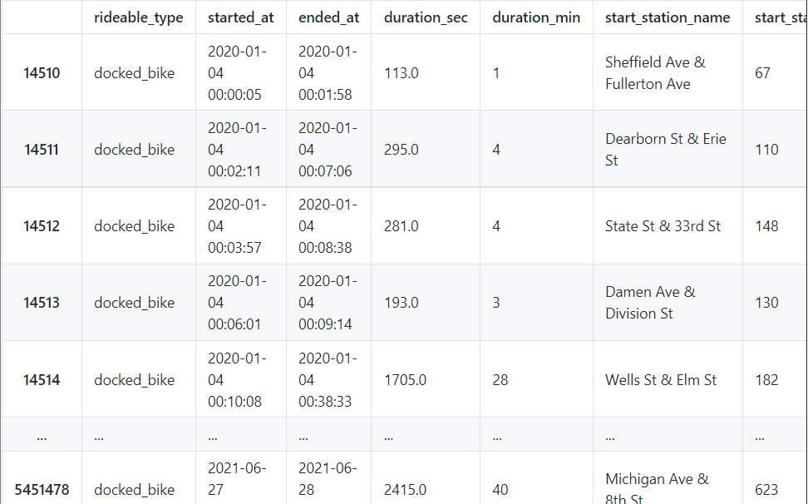
DATA Used is →
That Big Brother Looks
Like this ↓
(Access data and cleaning steps from appendix)

Slide 11
Charts That form insights

Slide 12
Most Common Trip Duration
Casuals
Members
Rides more often for
9 to 10 minutes
76K and 75K times respectively
Last year
Rides more often for
5 to 6 minutes
207K and 204K times respectively
Last year

Slide 13
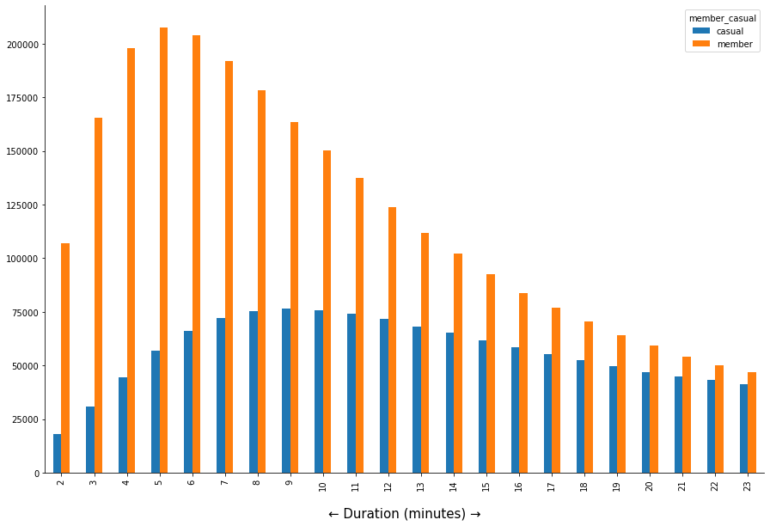
Top 20 Common Ride Time
Notes:
From overall data, casuals tend to ride longer than the members.

Slide 14
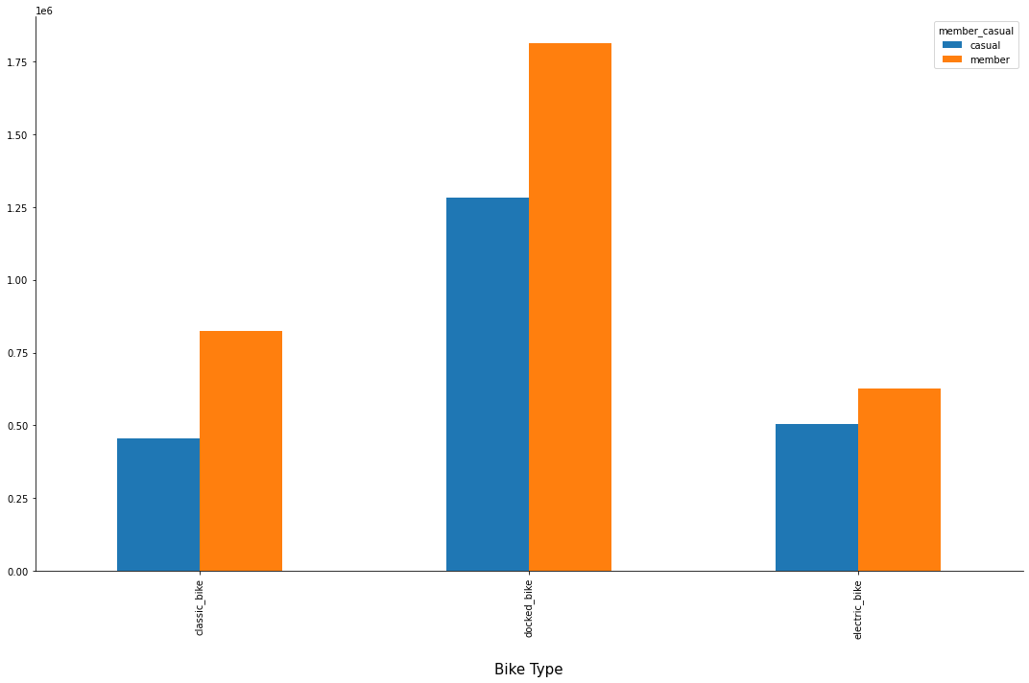
If we look at the bike types

Slide 16
What can we say from the bike and riders?
Insights:
——
• The Docked Bike is used
By both type of users.
• The Electric Bikes are the
Least used but looking at the
Proportion of total casual
Users, they tend to use more
Electric Bikes.

Slide 17
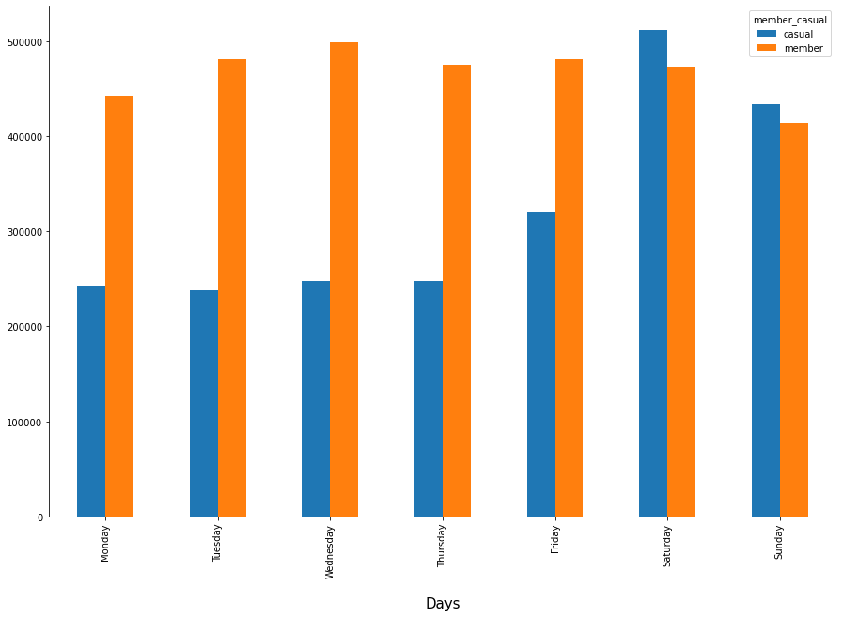
Weekly Traffic
Distribution
—
1.
Casuals tend to ride
The most on Saturdays (59%)
2.
Weekdays (Mon-Fri) has shown almost 50% less traffic of casuals than members.
Notes:
2. Casuals travel more than members on saturdays and sundays
3. Members use the rides almost at the steady level throughout the week
4. Members tend to use the most rides on Wed.

Slide 18
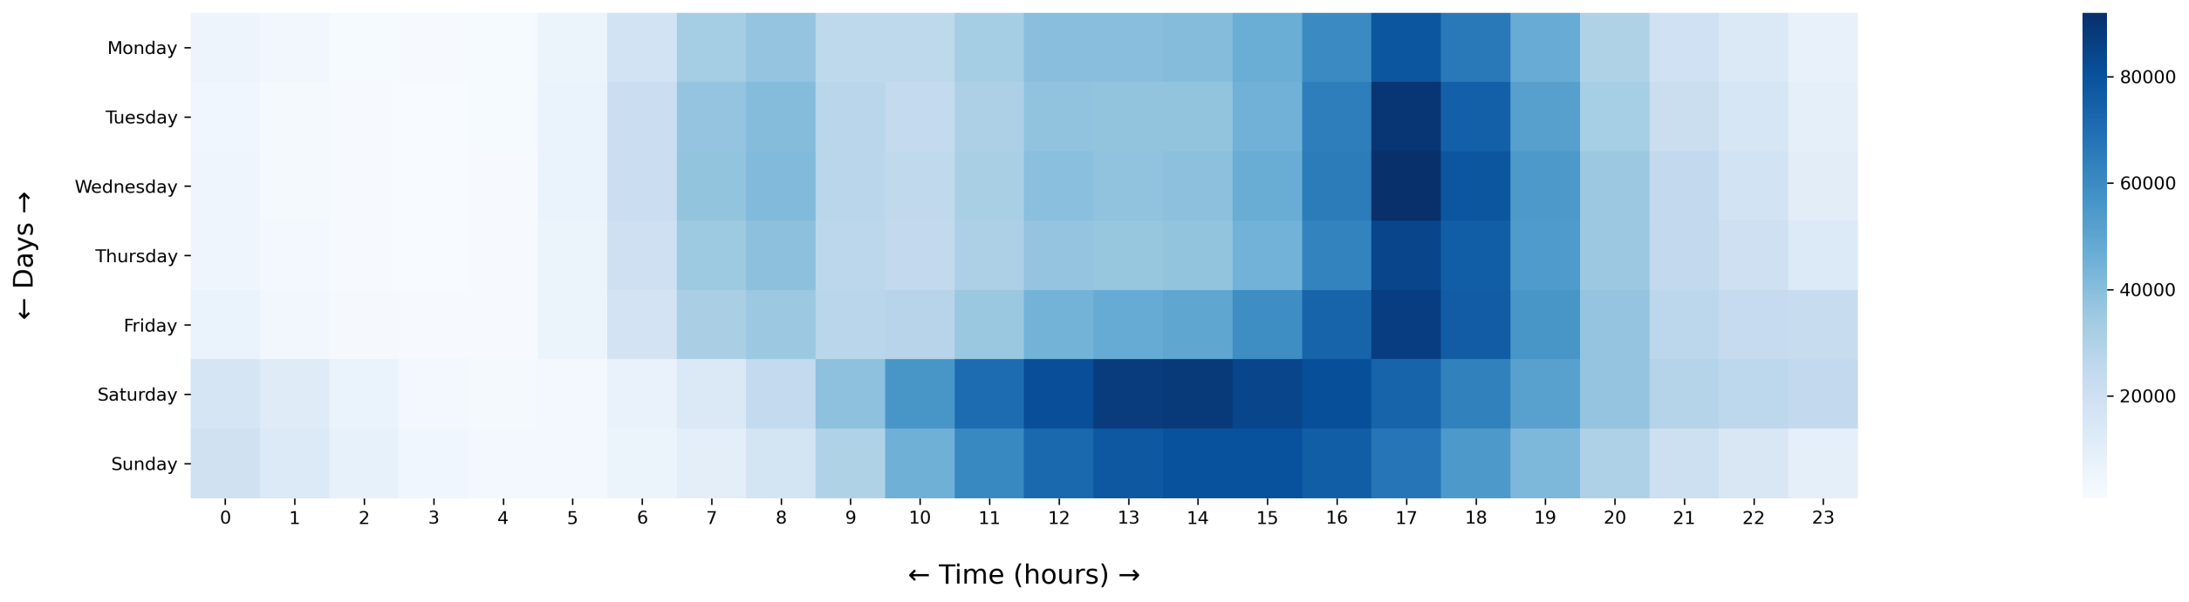
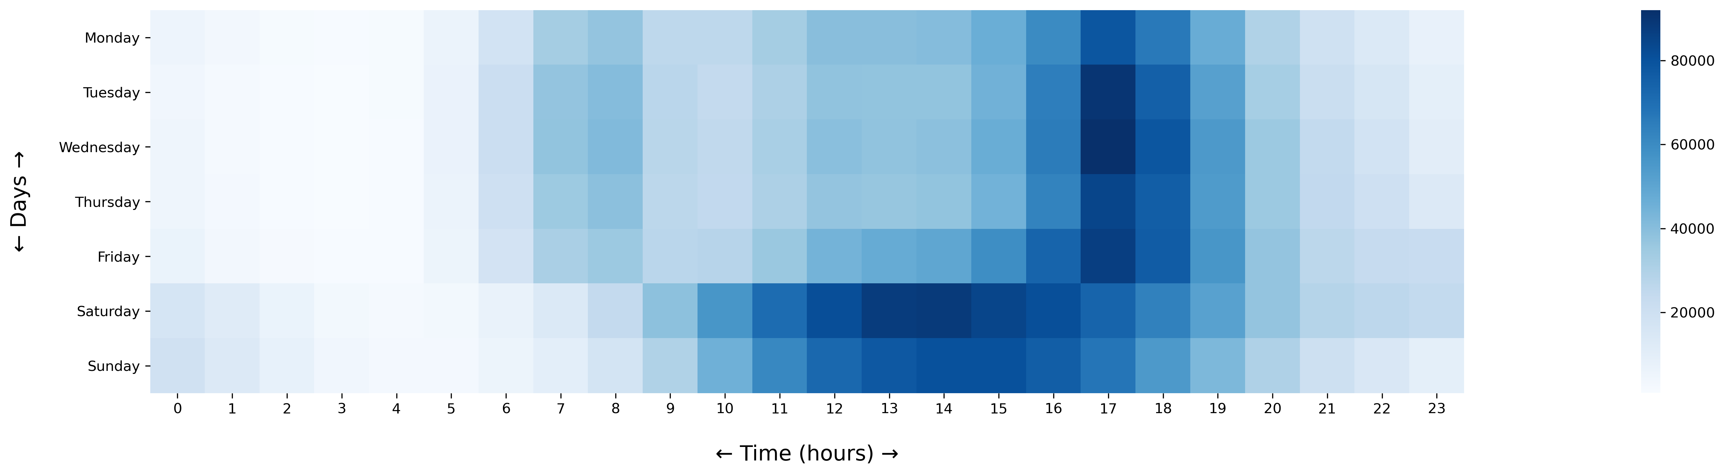
Hourly traffic by Week
(both users)
Notes:
On Saturday and sundays, instead of having the highest demand at 4pm and 5pm we have the highest demand at 2pm. Starting from 11am to 4pm.
When I looked closer in the data, I found the rides on sat-sun between 11 to 4 are travelled “less distance” than the rest on sat-sun
But surprisingly, on sat-sun the rides between 11 to 4 are “long travelled” than the rest days’ 11 to 4.

Slide 19
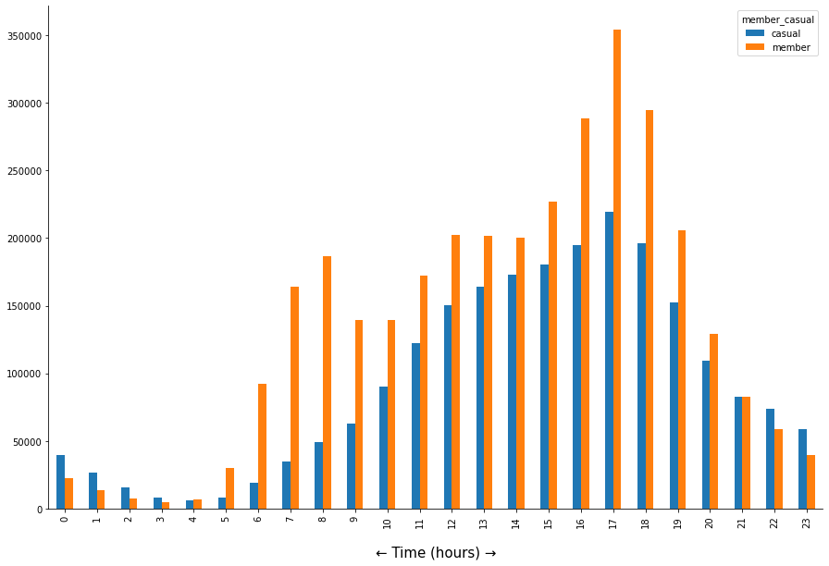
Hourly Traffic
Shows the distribution of traffic per hour
Insights:
——
→ Members pick rides actively from 6 AM to 12 AM
→ Members need the ride more than the casuals throughout the day
→ During Night time (from 9PM to 3 AM) casuals tend to be more active than the members
5 PM
8 AM
Notes:
3. In the morning 6 to 8 the demand increases for the ride, maybe because they go for gym or exercise
4. At 8 am the demand is highest in the morning phase
5. After 11 am the demand gradually increases and peaks at 4 PM
6. The lowest demand is at 3 am
7.

Slide 20
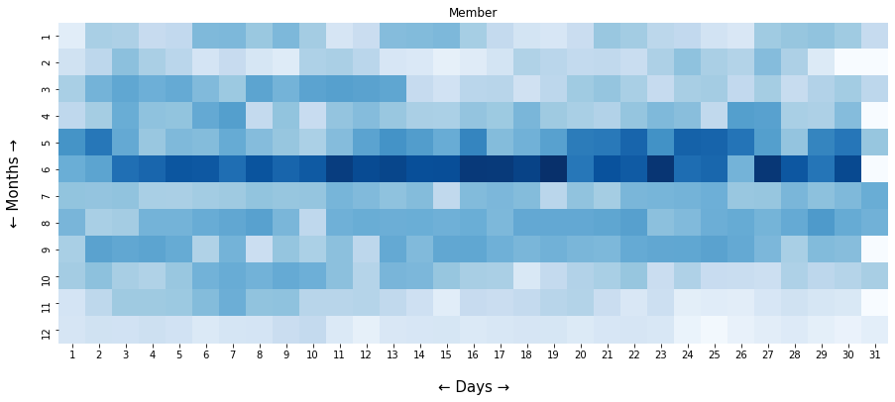
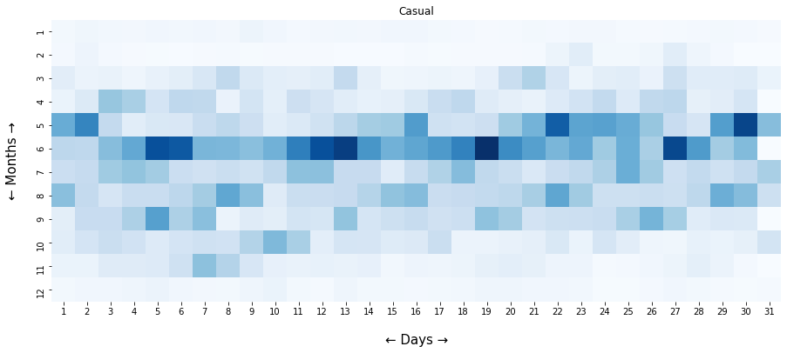

Slide 21
Ride activity per month by days
←
It is noticeable that
people tend to use more
rides in May and June
Jan-Feb and Nov-Dec have shown the least interest in compare to other months.
There is not much drop in usage of rides by Members in Jan-Feb and Nov-Dec like Casuals have.

Slide 22
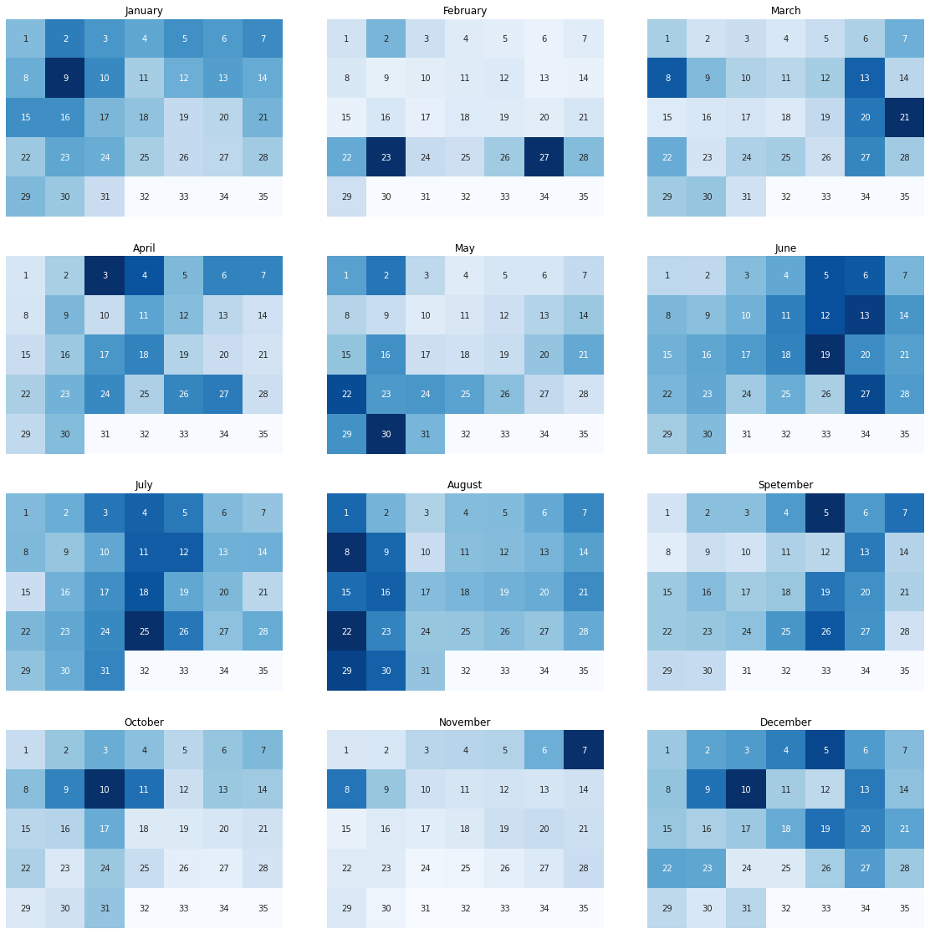
Casuals

Slide 23
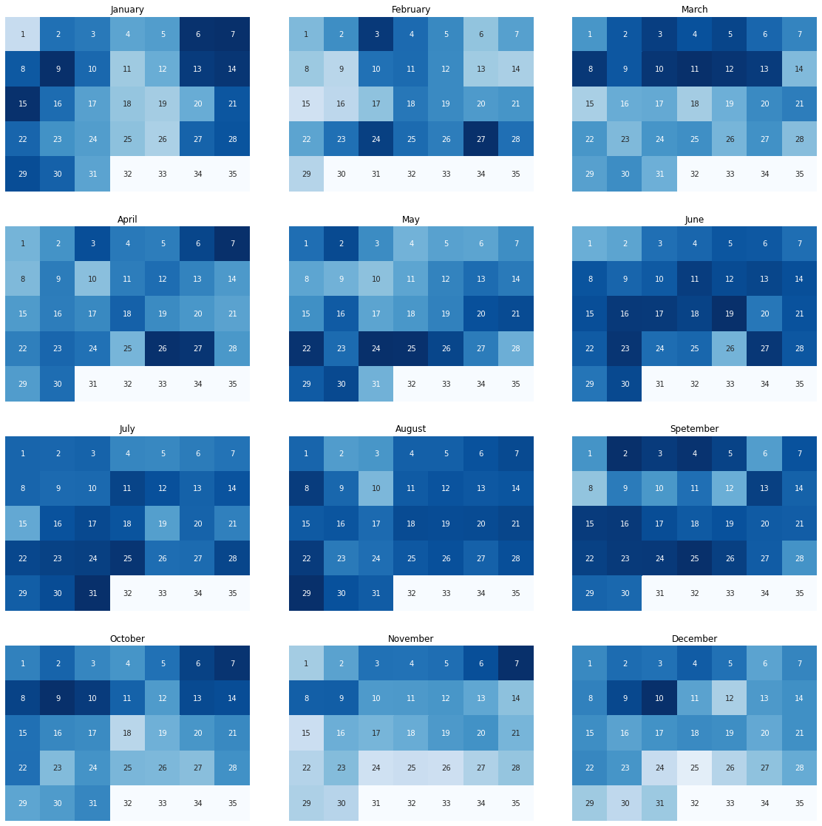
Members

Slide 24
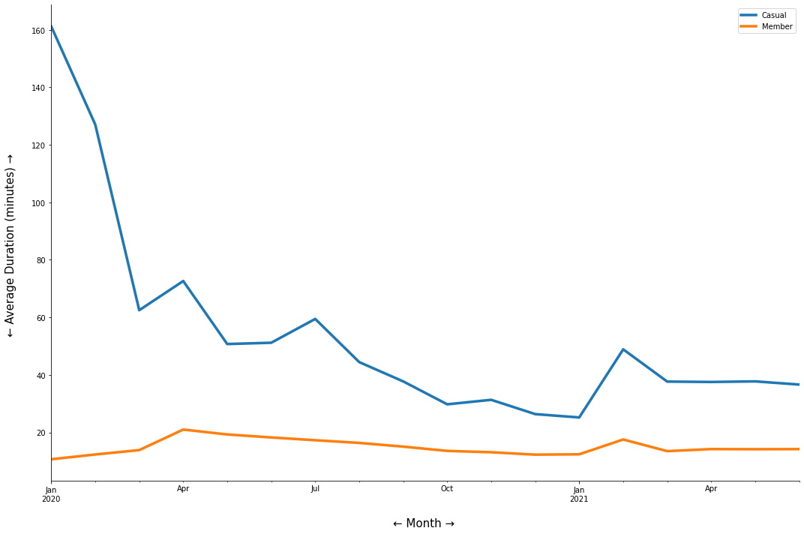
Monthly Average Duration
(minutes)
Insights:
——
The duration is always higher for the casuals than the members.
From this we can say that, casuals have
Shorter but more regular rides while casuals ride longer but they are irregular.
Notes:
1. For both of them, the duration declines in the starting of January 2021 and peak in duration can be seen in between Feb and March

Slide 25
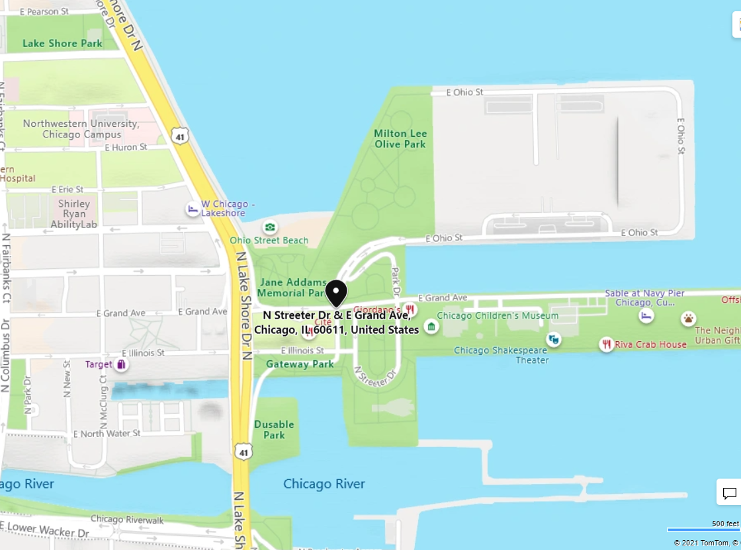
Casuals usually start their
ride from:
Streeter Dr and Grand Eve

Slide 26
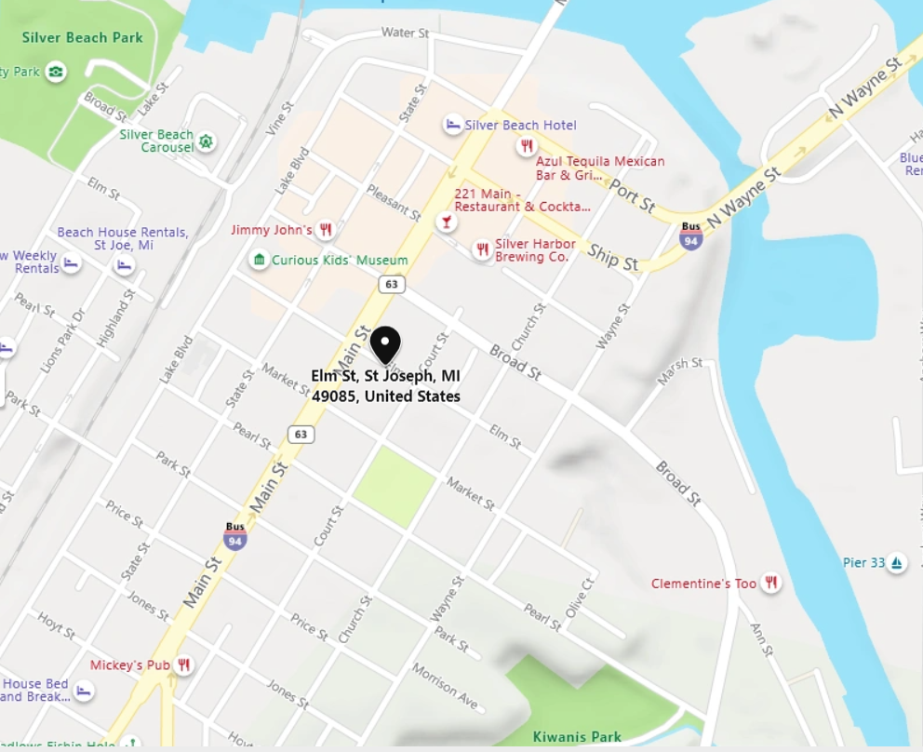
Members usually start their
ride from:
Clerk st
& Elm st

Slide 27

Some behaviors that differentiate them
Members usually are “Travelers” who start and end at different stations
Most of the Casuals start and end their ride at the same station.
Most commonly in both types of customers, if they are riding more than 1 Day — their common destination is:
HUBBARD STATION BIKE CHECKING

Slide 28
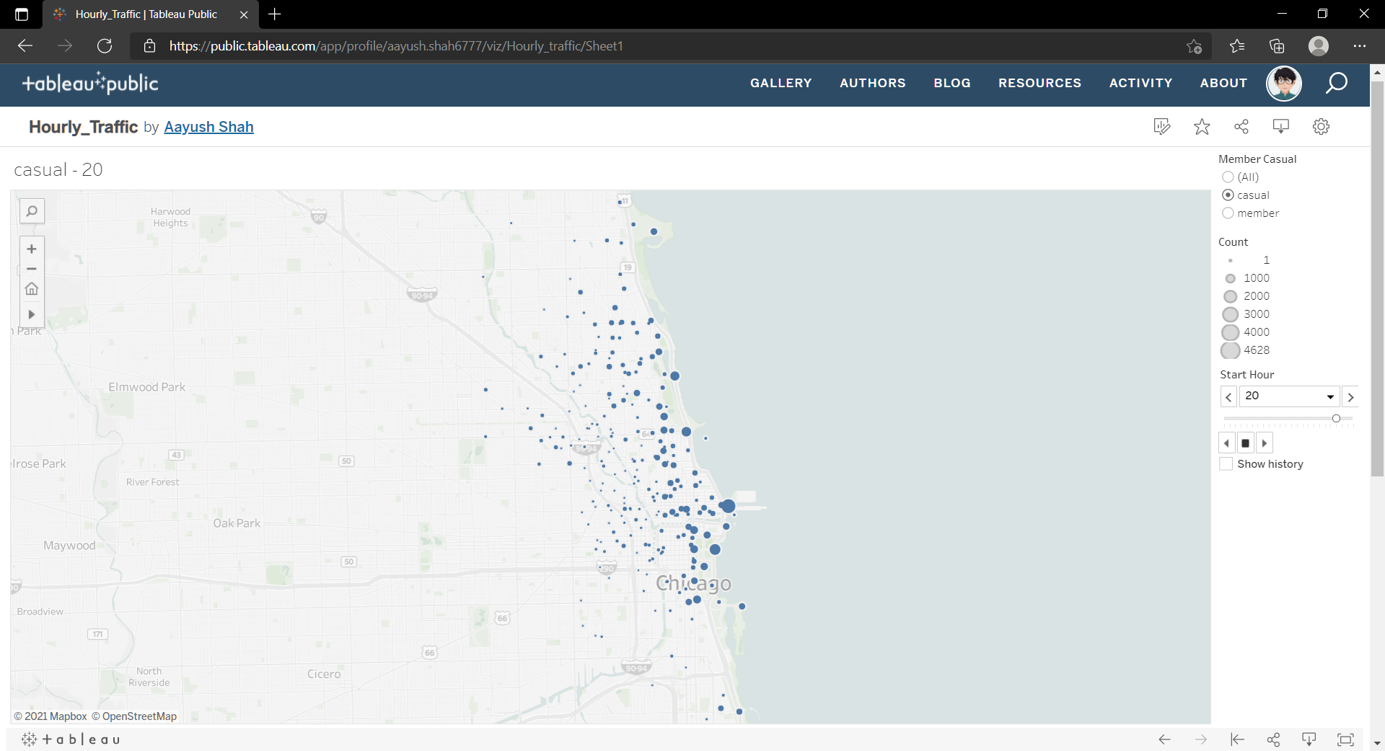
Please Visit
This → Link
For an interactive dashboard

Slide 29
Conclusion & Recommendations

Slide 30
Things to consider
2
1
3
Casuals are riding for longer duration (and also distance) than Members.
Members are those who need rides daily so they can be going for work or some kind of daily job.
Because also their numbers are less in weekends.
Electric bikes have shown a positive demand in casuals.
There can be potential of them.
Further analysis needed.

Slide 31
What can we do?
There are many limited amount of stations in the Clerk Theater which is distant from the center
—
There is rush. An increase in the station amount in those areas might result in high traffic of customers there.
Because many customers go for a longer distance
—
We can focus in those distant areas and spread the pearks of membership programs there.
Because casuals show an irregular ride demand
—
We may try to focus on those casuals who are regular but have not joined the membership plan. (Need a marketing strategy to attract them)

Slide 32
Feel Free to Ask

Slide 33
Appendix
Sources Used:
Wikipedia
Jupyter Notebook
Powerpoint

Slide 34
Thank You!

